Slide 1
Concurrency Problems in DBMS
When multiple transactions execute concurrently in an uncontrolled or unrestricted manner, then it might lead to several problems. Such problems are called as concurrency problems.

Slide 2
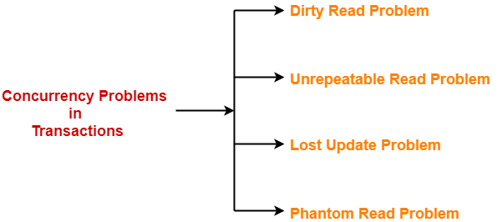
Concurrency Problems in DBMS
The concurrency problems are

Slide 3
Dirty Read Problem
Reading the data written by an uncommitted transaction is called as dirty read.
This read is called as dirty read because
There is always a chance that the uncommitted transaction might roll back later.
Thus, uncommitted transaction might make other transactions read a value that does not even exist.
This leads to inconsistency of the database.

Slide 4
Dirty Read Problem
NOTE
Dirty read does not always lead to inconsistency .
It becomes problematic only when the uncommitted transaction fails and roll backs later due to some reason.

Slide 5
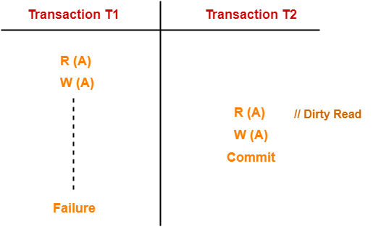

Slide 6
Dirty Read Problem
Here, T1 reads the value of A.
T1 updates the value of A in the buffer.
T2 reads the value of A from the buffer.
T2 writes the updated the value of A.
T2 commits.
T1 fails in later stages and rolls back.
In this example,
T2 reads the dirty value of A written by the uncommitted transaction
T1.
T1 fails in later stages and roll backs.
Thus, the value that T2 read now stands to be incorrect.
Therefore, database becomes inconsistent.

Slide 7
Unrepeatable Read Problem
This problem occurs when a transaction gets to read unrepeated i.e. different values of the same variable in its different read operations even when it has not updated its value.

Slide 8
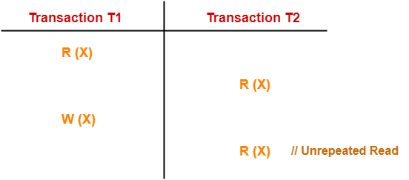
Unrepeatable Read Problem
Example

Slide 9
Unrepeatable Read Problem
T1 reads the value of X (= 10 say).
T2 reads the value of X (= 10).
T1 updates the value of X (from 10 to 15 say) in the buffer.
T2 again reads the value of X (but = 15).
In this example,
T2 gets to read a different value of X in its second reading.
T2 wonders how the value of X got changed because according to it, it is running in isolation.

Slide 10
Lost Update Problem
This problem occurs when multiple transactions execute concurrently and updates from one or more transactions get lost.

Slide 11
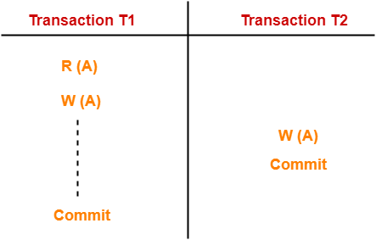
Lost Update Problem

Slide 12
Lost Update Problem
Here,
T1 reads the value of A (= 10 say).
T2 updates the value to A (= 15 say) in the buffer.
T2 does blind write A = 25 (write without read) in the buffer.
T2 commits.
When T1 commits, it writes A = 25 in the database.
In this example,
T1 writes the over written value of X in the database.
Thus, update from T1 gets lost.

Slide 13
Lost Update Problem
NOTE-
This problem occurs whenever there is a write-write conflict.
In write-write conflict, there are two writes one by each transaction on the same data item without any read in the middle.

Slide 14
Phantom Read Problem
This problem occurs when a transaction reads some variable from the buffer and when it reads the same variable later, it finds that the variable does not exist.

Slide 15
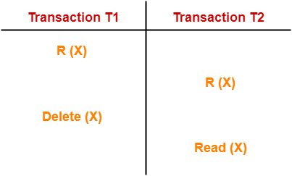
Phantom Read Problem

Slide 16
Phantom Read Problem
Here,
T1 reads X.
T2 reads X.
T1 deletes X.
T2 tries reading X but does not find it.
In this example,
T2 finds that there does not exist any variable X when it tries reading X again.
T2 wonders who deleted the variable X because according to it, it is running in isolation.

Slide 17
Avoiding Concurrency Problems
To ensure consistency of the database, it is very important to prevent the occurrence of above problems.
Concurrency Control Protocols help to prevent the occurrence of above problems and maintain the consistency of the database.

Slide 18
Serializability
Transaction Management System

Slide 19
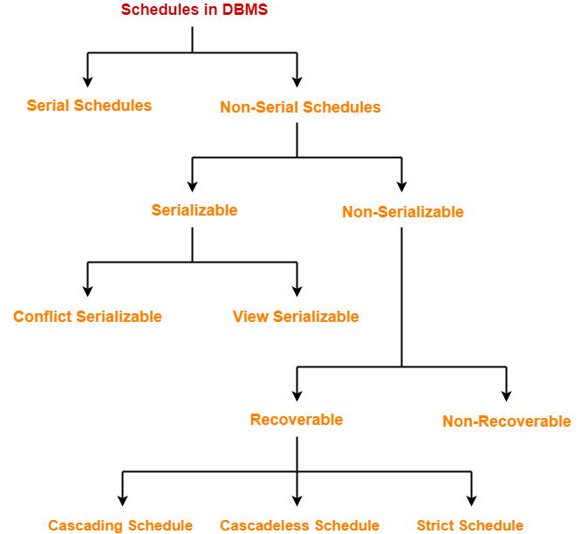

Slide 20
Serializability in DBMS
Some non-serial schedules may lead to inconsistency of the database.
Serializability is a concept that helps to identify which non-serial schedules are correct and will maintain the consistency of the database.

Slide 21
Characteristics of Serializable Schedules
Serializable schedules behave exactly same as serial schedules.
Thus, serializable schedules are always
Consistent
Recoverable
Cascadeless
Strict

Slide 22
Serializable Schedules
If a given non-serial schedule of ‘n’ transactions is equivalent to some serial schedule of ‘n’ transactions, then it is called as a serializable schedule.

Slide 23
Serial Schedules Vs Serializable Schedules
Serial Schedules | Serializable Schedules
No concurrency is allowed. Thus, all the transactions necessarily execute serially one after the other. | Concurrency is allowed. Thus, multiple transactions can execute concurrently.
Serial schedules lead to less resource utilization and CPU throughput. | Serializable schedules improve both resource utilization and CPU throughput.
Serial Schedules are less efficient as compared to serializable schedules. (due to above reason) | Serializable Schedules are always better than serial schedules. (due to above reason)

Slide 24
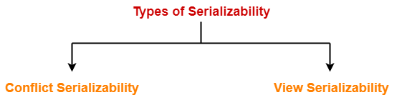
Types of Serializability
Serializability is mainly of two types
Conflict Serializability
View Serializability

Slide 25
Conflict Serializability
If a given non-serial schedule can be converted into a serial schedule by swapping its non-conflicting operations, then it is called as a conflict serializable schedule.

Slide 26
Conflicting Operations
Two operations are called as conflicting operations if all the following conditions hold true for them.
Both the operations belong to different transactions
Both the operations are on the same data item
At least one of the two operations is a write operation

Slide 27
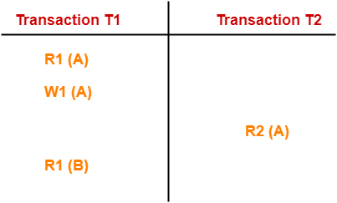
Conflicting Operations
Consider the following schedule-

Slide 28
Conflicting Operations
In this schedule,
W1 (A) and R2 (A) are called as conflicting
operations.
This is because all the above conditions hold true for them.

Slide 29
Checking Whether a Schedule is Conflict Serializable Or Not
Follow the following steps to check whether a given non-serial schedule is conflict serializable or not-
Step-01:
Find and list all the conflicting operations.
Step-02:
Start creating a precedence graph by drawing
one node for each transaction.

Slide 30
Checking Whether a Schedule is Conflict Serializable Or Not
Step-03:
Draw an edge for each conflict pair such that if
X_{i} (V) and Y_{j} (V) forms a conflict pair then draw an
edge from T_{i} to T_{j}. This ensures that T_{i} gets
executed before T_{j}.
Step-04:
Check if there is any cycle formed in the graph.
If there is no cycle found, then the schedule is
conflict serializable otherwise not.

Slide 31
View Serializability
If a given schedule is found to be view equivalent to some serial schedule, then it is called as a view serializable schedule.

Slide 32
View Equivalent Schedules
Consider two schedules S1 and S2 each consisting of two transactions T1 and T2.
Schedules S1 and S2 are called view equivalent if the following three conditions hold true for them

Slide 33
View Equivalent Schedules
Condition-01:
For each data item X, if transaction T_{i} reads X from the database initially in schedule S1, then in schedule S2 also, T_{i} must perform the initial read of X from the database.

Slide 34
View Equivalent Schedules
Condition-02:
If transaction T_{i} reads a data item that has been updated by the transaction T_{j} in schedule S1, then in schedule S2 also, transaction T_{i} must read the same data item that has been updated by the transaction T_{j.}

Slide 35
View Equivalent Schedules
Condition-03:
For each data item X, if X has been updated at last by transaction T_{i} in schedule S1, then in schedule S2 also, X must be updated at last by transaction T_{i}.

Slide 36
Checking Whether a Schedule is View Serializable Or Not
Method-01:
Check whether the given schedule is conflict serializable or not.
If the given schedule is conflict serializable, then it is surely view serializable. Stop and report your answer.
If the given schedule is not conflict serializable, then it may or may not be view serializable. Go and check using other methods.

Slide 37
Checking Whether a Schedule is View Serializable Or Not
All conflict serializable schedules are view serializable.
All view serializable schedules may or may not be conflict serializable.

Slide 38
Checking Whether a Schedule is View Serializable Or Not
Method-02:
Check if there exists any blind write operation.
(Writing without reading is called as a blind write).
If there does not exist any blind write, then the schedule is surely not view serializable. Stop and report your answer.
If there exists any blind write, then the schedule may or may not be view serializable. Go and check using other methods.

Slide 39
Checking Whether a Schedule is View Serializable Or Not
No blind write means not a view serializable schedule.

Slide 40
Checking Whether a Schedule is View Serializable Or Not
Method-03:
In this method, try finding a view equivalent serial schedule.
By using the above three conditions, write all the dependencies.
Then, draw a graph using those dependencies.
If there exists no cycle in the graph, then the schedule is view serializable otherwise not.

Slide 41
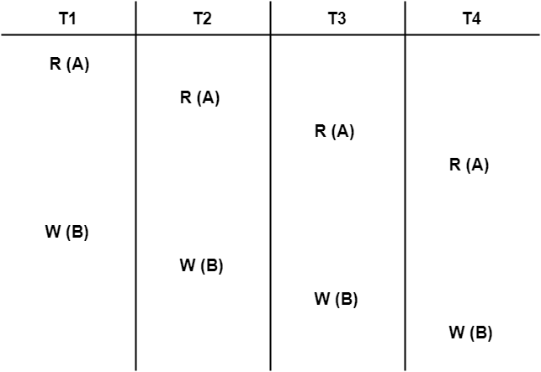
Problem-01
Check whether the given schedule S is view serializable or not.

Slide 42
Solution
We know, if a schedule is conflict serializable, then it is surely view serializable.
So, let us check whether the given schedule is conflict serializable or not.

Slide 43
Solution
Checking Whether S is Conflict Serializable Or Not
Step-01:
List all the conflicting operations and determine the dependency between the transactions-
W₁(B) , W₂(B) (T₁ → T₂)
W₁(B) , W₃(B) (T₁ → T₃)
W₁(B) , W₄(B) (T₁ → T₄)
W₂(B) , W₃(B) (T₂ → T₃)
W₂(B) , W₄(B) (T₂ → T₄)
W₃(B) , W₄(B) (T₃ → T₄)

Slide 44
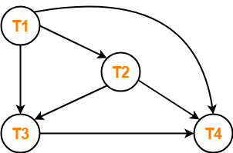
Solution
Step-02:
Draw the precedence graph.
Clearly, there exists no cycle in the precedence graph.
Therefore, the given schedule S is conflict serializable.
Thus, we conclude that the given schedule is also view serializable.

Slide 45
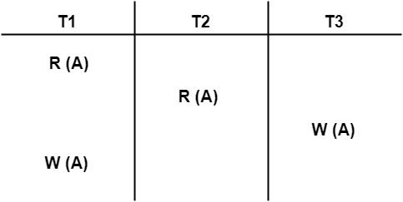
Problem-02:
Check whether the given schedule S is view serializable or not-

Slide 46
Solution-
We know, if a schedule is conflict serializable, then it is surely view serializable.
So, let us check whether the given schedule is conflict serializable or not.
Checking Whether S is Conflict Serializable Or Not
Step-01:
List all the conflicting operations and determine the dependency between the transactions.

Slide 47
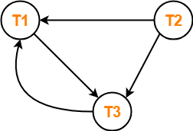
Solution-
R₁(A) , W₃(A) (T₁ → T₃)
R₂(A) , W₃(A) (T₂ → T₃)
R₂(A) , W₁(A) (T₂ → T₁)
W₃(A) , W₁(A) (T₃ → T₁)
Step-02: Draw the precedence graph.

Slide 48
Solution-
Clearly, there exists a cycle in the precedence graph. Therefore, the given schedule S is not conflict serializable.
Since, the given schedule S is not conflict serializable, so, it may or may not be view serializable.
To check whether S is view serializable or not, let us use another method.
Let us check for blind writes.

Slide 49
Solution-
Checking for Blind Writes-
There exists a blind write W₃ (A) in the given schedule S.
Therefore, the given schedule S may or may not be view serializable.
Now, To check whether S is view serializable or not, let us use another method.
Let us derive the dependencies and then draw a dependency graph.

Slide 50
Solution-
Drawing a Dependency Graph-
T1 firstly reads A and T3 firstly updates A. So, T1 must execute before T3.
Thus, we get the dependency T1 → T3.
Finally updating on A is made by the transaction T1. So, T1 must execute after all other transactions.
Thus, we get the dependency (T2, T3) → T1. There exists no write-read sequence.
Now, let us draw a dependency graph using these dependencies

Slide 51
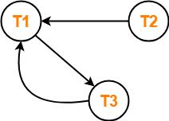
Solution-
Clearly, there exists a cycle in the dependency graph.
Thus, we conclude that the given schedule S is not view serializable.

Slide 52
Problem-03:
Check whether the given schedule S is view serializable or not-

Slide 53
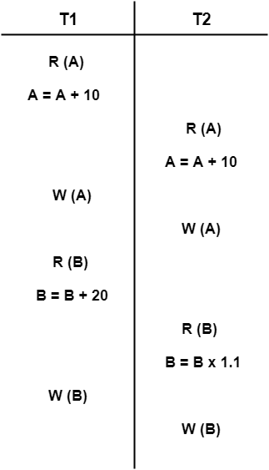

Slide 54
Solution-
We know, if a schedule is conflict serializable,
then it is surely view serializable.
So, let us check whether the given schedule is
conflict serializable or not.

Slide 55
Solution-
Checking Whether S is Conflict Serializable Or Not-
Step-01:
List all the conflicting operations and determine the dependency between the transactions-
R₁(A) , W₂(A) (T₁ → T₂)
R₂(A) , W₁(A) (T₂ → T₁)
W₁(A) , W₂(A) (T₁ → T₂)
R₁(B) , W₂(B) (T₁ → T₂)
R₂(B) , W₁(B) (T₂ → T₁)

Slide 56
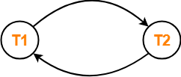
Solution-
Step-02:
Draw the precedence graph-

Slide 57
Solution-
Clearly, there exists a cycle in the precedence graph. Therefore, the given schedule S is not conflict serializable.
Since, the given schedule S is not conflict serializable, so, it may or may not be view serializable.
To check whether S is view serializable or not, let us use another method. Let us check for blind writes.

Slide 58
Solution-
Checking for Blind Writes-
There exists no blind write in the given schedule S.
Therefore, it is surely not view serializable.

Slide 59
Problem-04:
Check whether the given schedule S is view serializable or not. If yes, then give the serial schedule.
S : R₁(A) , W₂(A) , R₃(A) , W₁(A) , W₃(A)
Solution-
For simplicity and better understanding, we can represent the given schedule pictorially as.

Slide 60
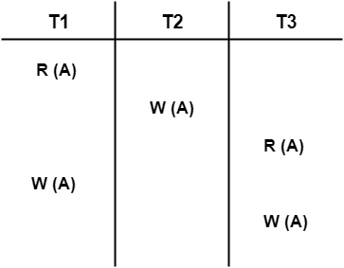
Solution-

Slide 61
Solution-
We know, if a schedule is conflict serializable, then it is surely view serializable. So, let us check whether the given schedule is conflict serializable or not.
Checking Whether S is Conflict Serializable Or Not-
Step-01:
List all the conflicting operations and determine the dependency between the transactions-
R₁(A) , W₂(A) (T₁ → T₂)
R₁(A) , W₃(A) (T₁ → T₃)
W₂(A) , R₃(A) (T₂ → T₃)
W₂(A) , W₁(A) (T₂ → T₁)
W₂(A) , W₃(A) (T₂ → T₃)
R₃(A) , W₁(A) (T₃ → T₁)
W₁(A) , W₃(A) (T₁ → T₃)

Slide 62
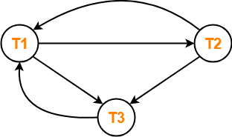
Solution-
Step-02:
Draw the precedence graph.

Slide 63
Solution-
Clearly, there exists a cycle in the precedence graph.
Therefore, the given schedule S is not conflict serializable.

Slide 64
Solution-
Now, Since, the given schedule S is not conflict serializable, so, it may or may not be view serializable.
To check whether S is view serializable or not, let us use another method. Let us check for blind writes.
Checking for Blind Writes-
There exists a blind write W₂ (A) in the given schedule S.
Therefore, the given schedule S may or may not be view serializable.
Now, To check whether S is view serializable or not, let us use another method.
Let us derive the dependencies and then draw a dependency graph.

Slide 65
Solution-
Drawing a Dependency Graph-
T1 firstly reads A and T2 firstly updates A.
So, T1 must execute before T2.
Thus, we get the dependency T1 → T2.
Final updation on A is made by the transaction T3.
So, T3 must execute after all other transactions.
Thus, we get the dependency (T1, T2) → T3.
From write-read sequence, we get the dependency T2 → T3
Now, let us draw a dependency graph using these dependencies-

Slide 66
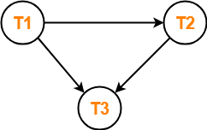
Solution-
Step-02:
Draw the precedence graph.

Slide 67
Solution-
Clearly, there exists no cycle in the dependency graph.
Therefore, the given schedule S is view serializable.
The serialization order T1 → T2 → T3.

